Slide 1


POTHOLES DETECTION

Slide 2
CONTENTS
ABSTRACT
INTRODUCTION
PROPOSED SYSTEM
METHODOLOGY
MACHINE LEARNING CLASSIFICATION
EVALUATION
IMPACT
RESULTS
CONCLUSION

Slide 3
ABSTRACT
Road surface monitoring and maintenance are essential for driving comfort, transport safety and preserving infrastructure integrity.
A series of processing methods were applied to the collected data, and features from different frequency domains were extracted, along with various machine-learning classifiers.
.

Slide 4
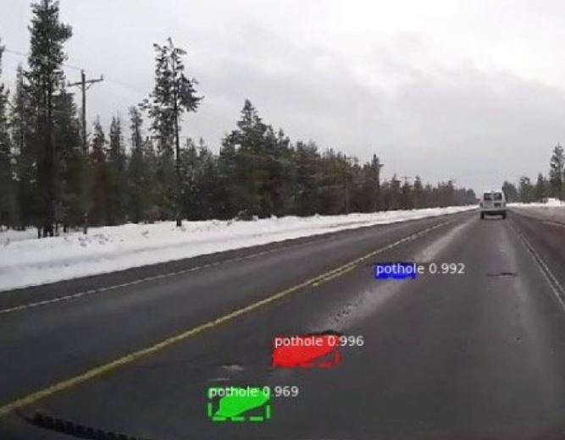
INTRODUCTION
Machine learning algorithms can be helpful in this area, the data generated by these sensors can be used to create a classification model that will detect the presence of crack or potholes on the road then we can record the location on a public data accessible database.

Slide 5
PROPOSED SYSTEM
The server back-end extracts feature from the uploaded data after signal transformation and identifies real potholes by using pretrained machine-learning classifiers.

Slide 6
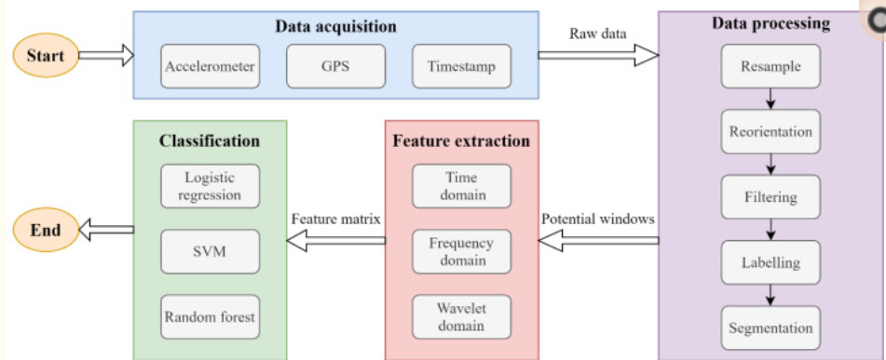
METHODOLOGY
The objective of this study is to develop a method for detecting potholes using vibration sensors embedded in smartphones.
The general workflow consists of four stages:
(1) data acquisition
(2) data processing
(3) feature extraction
(4) classification.

Slide 7
MACHINE LEARNING CLASSIFICATION
Machine learning algorithms can be helpful in this area, the data generated by these sensors can be used to create a classification model that will detect the presence of crack or potholes on the road then we can record the location on a public data accessible database.

Slide 8
EVALUATION
To evaluate the performance of the a fore mentioned feature domains and algorithms, we adopted evaluation criteria from different aspects.
Therefore, we compare the times required for feature extraction from different domains.
This is classified as confusion matrix based on the numbers of true positives (TP), true negatives (TN), false positives (FP), and false negatives (FN)

Slide 9
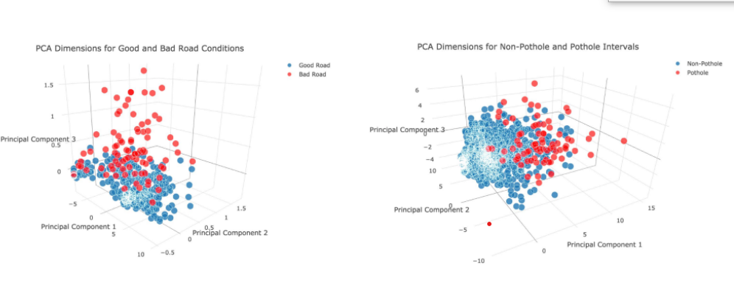
IMPACT
Here are two plots visualizing points from the first three principal components of the gyroscope, accelerometer, and speed attributes, colored by their labels (good road/bad road and pothole/non-pothole).

Slide 10
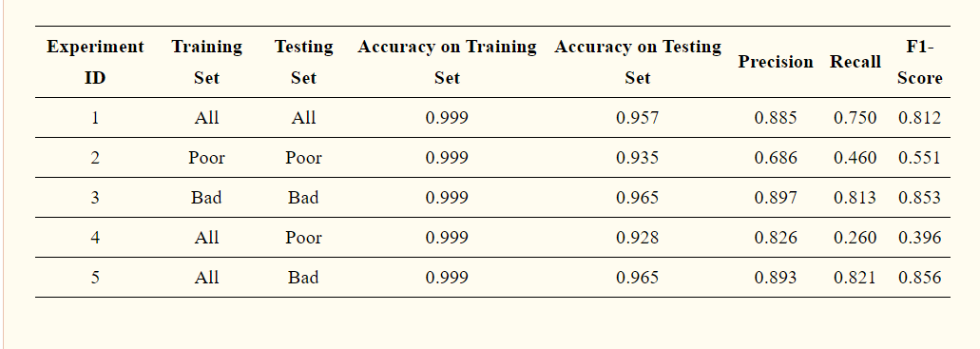
RESULTS The precision, recall, and f1-score correspond to ‘pothole’ The precision, recall, and f1-score correspond to ‘pothole’

Slide 11
CONCLUSION
If we can detect and record the locations of these potholes, we can save many lives and assets. Combinations of machine learning algorithms and sensor data will be helpful in eliminating these pothole problems.

